Slide 1

Record Label Smart Contract

Slide 2
Artist and Label Agreements
Hold funds in a vested wallet
Funds released upon conditions satisfied
Meant as an investment vehicle for artist
Contract is immutable upon execution
Offers transparency to finances and terms

Slide 3
Contract Structure
We serve as a third party contract provider with no involvement in talks
Terms decided prior to execution by negotiations
Holds agreed percentage payout
Protects all parties involved

Slide 4

Vesting Wallet
Handles the vesting of Ether and ERC20 tokens for a given beneficiary
Custody of multiple tokens can be given to this contract, which will release the token to the beneficiary following a given, customizable, vesting schedule.
Any token transferred to this contract will follow the vesting schedule as if they were locked from the beginning
Consequently, if the vesting has already started, any amount of tokens sent to this contract will (at least partly) be immediately releasable.

Slide 5
Solutions
Solve disputes on terms, conditions, and payment by clearly defining details through math not wording
Introduces protections such as under performance, royalty protections, etc
Solves trust factor upon contract initiation

Slide 6
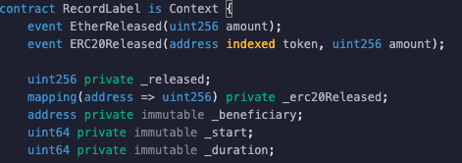
Code Features
Imports

Slide 7
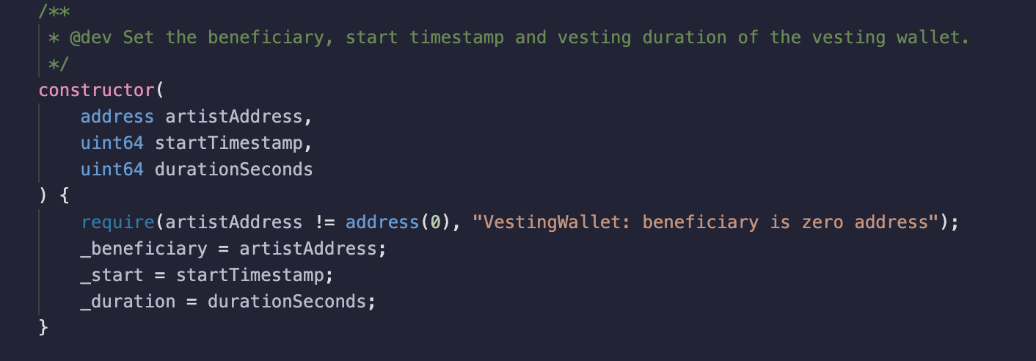
Code Features
Constructor

Slide 8
Benefits
Allows each artist address to be uniquely input
Set start time (in UTC)
Set duration (in UTC)

Slide 9
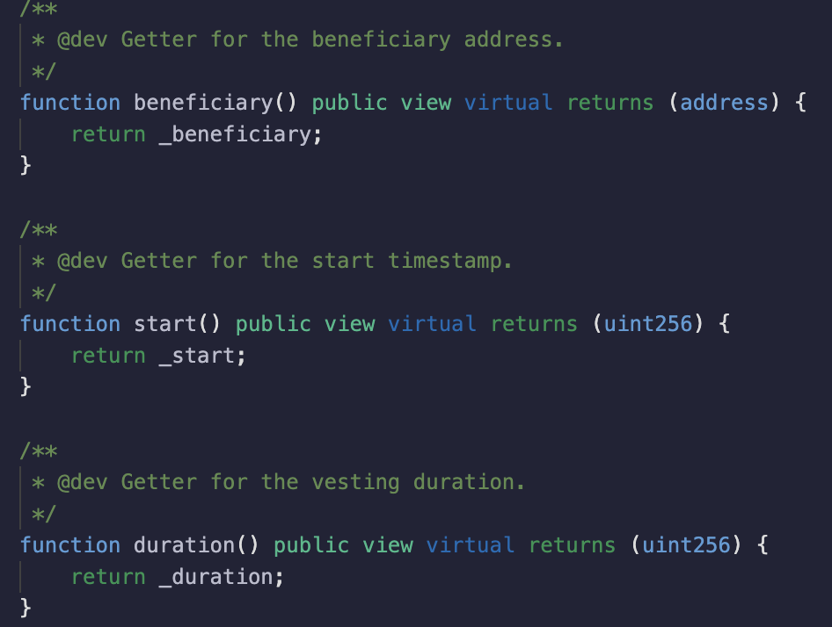
Code Features
Getters

Slide 10
Benefits
When functions executed, gets values set prior to constructor
Returns only variables which were input upfront
Accurate, efficient, immutable

Slide 11
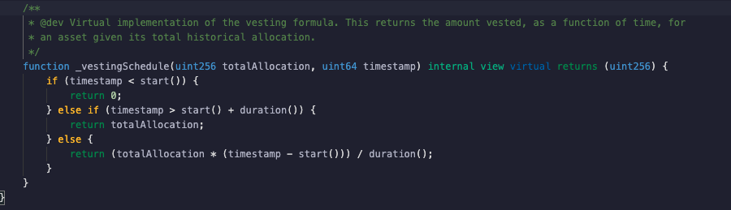
Code Features
Vesting Schedule formula

Slide 12
Benefits
Prohibits token distribution before contract start
Sends all tokens to artist immediately if contract expired
Distributes precisely what artist owed

Slide 13
Future Additions and Improvements
Simple and easy to use User Interface
All-In-One Smart Contract Builder
Insurance Protections for Vested Funds

Slide 14
Join the Team
Slack
Telegram
Email
Github

